Slide 1
Decision Trees
Week 6
Mohammad Esmalifalak

Slide 2
Decision Tree
What is a decision tree?
How decision tree classifies observations?
How can I create a decision tree?

Slide 3
Decision Tree
Classification Tree
x2
X1>2
N
Y
(0,8)
X2>3
3
N
Y
X1>3
X1>4
N
Y
N
Y
x1
2
4
(7,1)
(2,6)
(4,0)
(8,0)

Slide 4
Decision Tree
Growing a Tree in an efficient way
x2
x2
3
3
x1
x1
2
2
4
4

Slide 5
Decision Tree
Entropy= -p(R) log(p(R)) -p(B) log(p(B))
x2
Entropy=-13/27xlog2(13/27)-
14/27xlog2(13/27)=0.99
Entropy=-0-1xlog2(1)=0
3
x1
2
4

Slide 6
Decision Tree
Entropy= -p(R) log(p(R)) -p(B) log(p(B))
x2
Entropy=-4/13xlog2(4/13) - 9/13xlog2(9/13)=0.89
3
Entropy=-9/22xlog2(9/22) - 13/22xlog2(13/22)=0.97
x1
2
4

Slide 7
Decision Tree
Information Gain= (Entropy before split) – (Weighted entropy after split)
x2
Entropy before split=0.95
x2
Entropy=0.89
3
3
Entropy=0
Entropy=0.99
Entropy=0.97
x1
x1
2
2
4
4
Information Gain=
.95 - ((13/35)*0.89 + (22/35)*.97 ) =0.01
Information Gain= 0.95-( 0 + (27/35)*.99) = 0.19

Slide 8
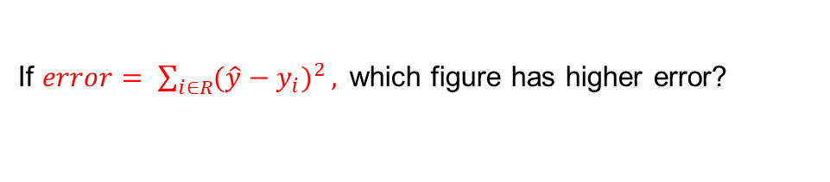
Decision Tree
Regression Tree
y
y
3
3
x
x
2
4
2
4
If $error= \sum_{i∈R}{{(\hat{y}−y_{i})}^{2}},$which figure has higher error?

Slide 9




Decision Tree
Regression Tree
X>1.8
y
N
Y
$$\hat{y}=2$$
X>4
4
N
Y
2
X>3
$$\hat{y}=1.8$$
N
Y
x
4
$$\hat{y}=4$$
$$\hat{y}=3$$
2

Slide 10
Decision Tree-Advantages
Simple to understand and to interpret. Trees can be visualized.
Requires little data preparation (normalization, dummy variables)
Cost of using tree (i.e., predicting data) is logarithmic in the number of data points used to train the tree.
Able to handle both numerical and categorical data (other techniques are usually specialized)
Uses a white box model (Results are easy to interpret, unlike black box model such as NN).

Slide 11
Decision Tree-Disadvantages
Can create over-complex trees that do not generalize the data well (overfitting).
Can be unstable because small variations in the data might result in a completely different tree being generated. This problem is mitigated by using decision trees within an ensemble.
Practical decision-tree learning algorithms are based on heuristic algorithms such as the greedy algorithm (locally optimal decisions are made at each node). Such algorithms cannot guarantee to return the globally optimal decision tree.
There are concepts that are hard to learn because decision trees do not express them easily, such as XOR, parity or multiplexer problems.
Decision tree learners create biased trees if some classes dominate. It is therefore recommended to balance the dataset prior to fitting with the decision tree.

Slide 12
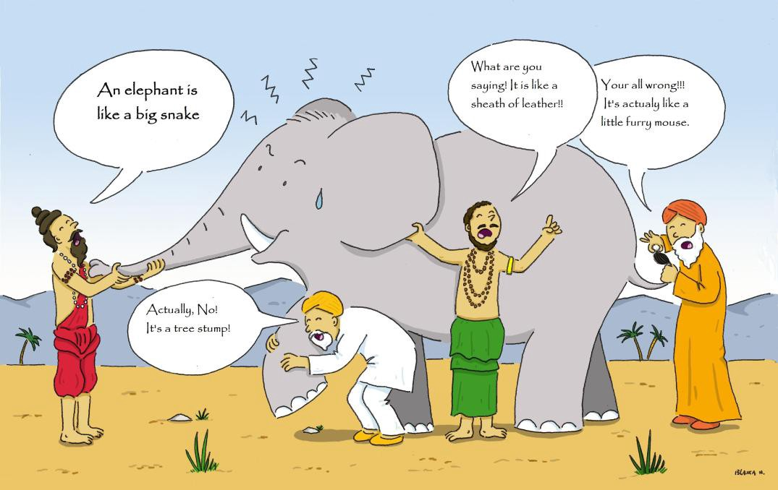
Ensemble Learning
Can a set of week learners create a strong learner together?

Slide 13
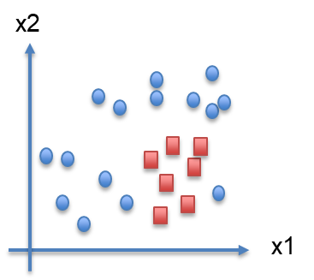
Ensemble Learning
Training:
Decision Tree
x2
Neural Net
x1
Logistic Reg.

Slide 14
Ensemble Learning
Testing:
Decision Tree
h1= 0
x2
h2= 0
h3= 1
Neural Net
x1
Vote=0
Xnew
Logistic Reg.

Slide 15
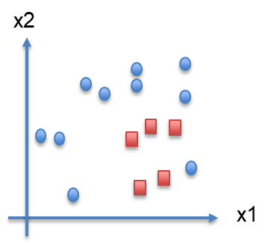
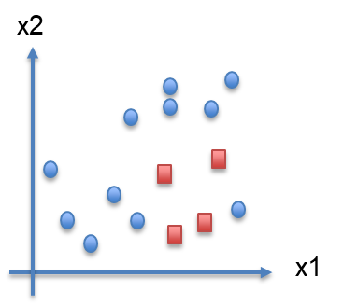
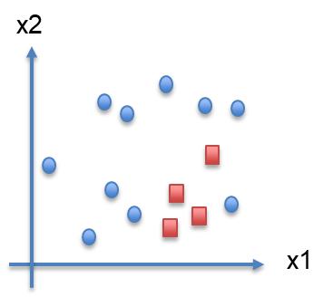
Bootstrap Aggregating (Bagging)
Classification
x2
Neural Net
Vote
Classification
Mean
Regression
Neural Net
x1
Neural Net

Slide 16









Bagging with Same Algorithm
Same algorithm with different sampling for training.
Random Pick with replacement.
Train
(70%)
$$n^{′}$$
$$n^{′}$$
$$n^{′}$$
$$D_{1}$$
$$D_{2}$$
$$D_{m}$$
X
$$h_{1}$$
X
$$h_{2}$$
X
$$h_{m}$$
Test
(30%)
Vote or mean

Slide 17
Bootstrap Aggregating (Bagging)
Regression
y
X

